Slide 1

Reinforcement Learning: Process Control Through Experience Gavin Taylor, USNA

Slide 2
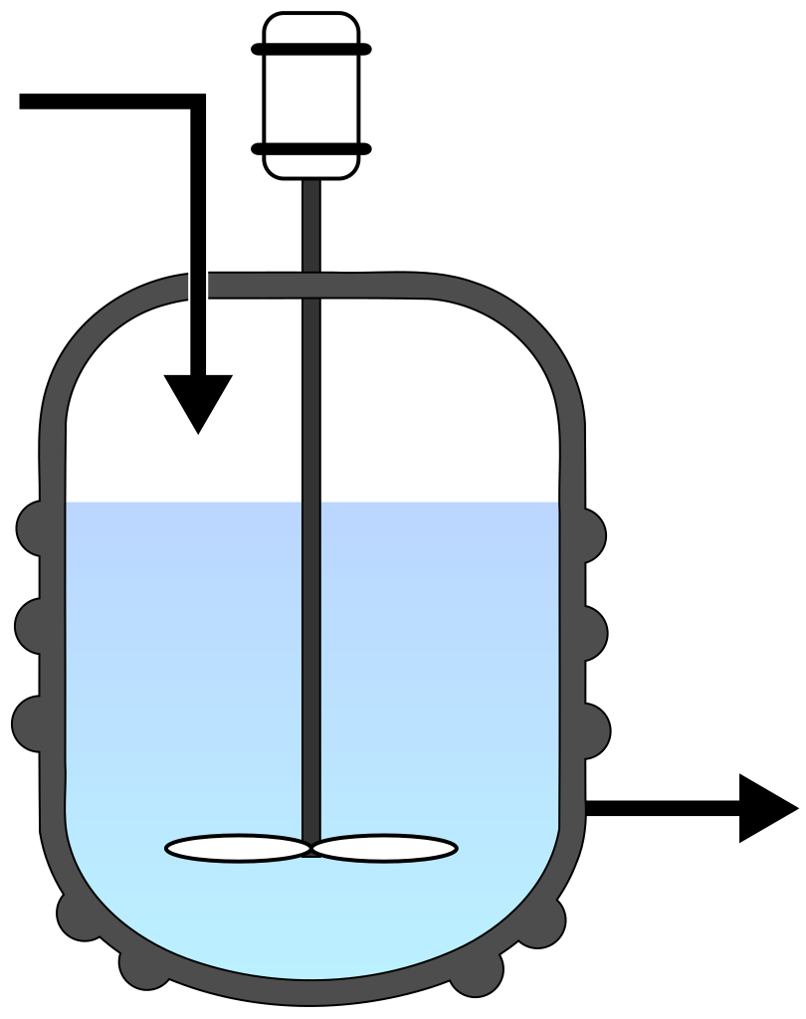
Constant flow of Chemical A
Controllable concentration
of Chemical B
Injection of heat
through steam jacket
Concentration of
Chemical C
Temperature of
solution

Slide 3
What if your model is wrong?
What if computing your controller’s solution is slow?
What if reality changes as system ages?

Slide 4
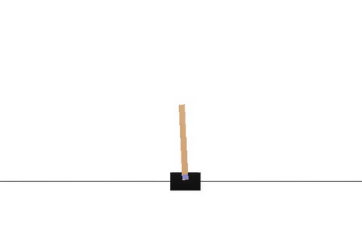

Slide 5
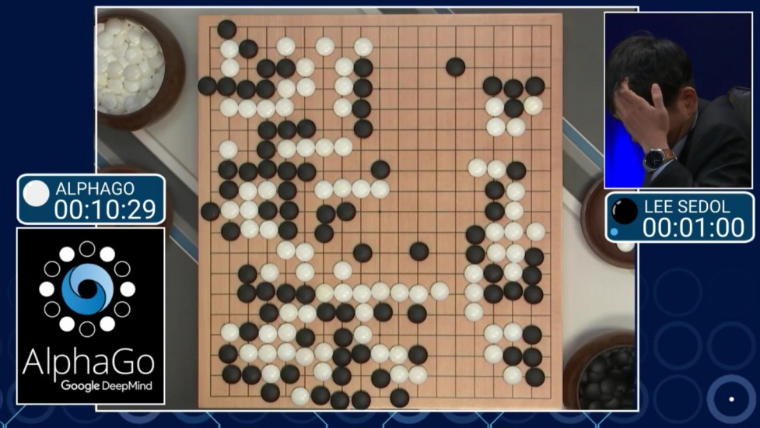

Slide 6
Mathematically, what is RL?
What makes RL hard?
What has changed in the last few years?
Results from application to process control

Slide 7
Mathematically, what is RL?
What makes RL hard?
What has changed in the last few years?
Results from application to process control

Slide 8
Markov Decision Processes
Notes:
Value function is useful for POLICY CREATION or POLICY EVALUATION

Slide 9
Markov Decision Processes
Notes:
Value function is useful for POLICY CREATION or POLICY EVALUATION

Slide 10
Markov Decision Processes
Policy
Notes:
Value function is useful for POLICY CREATION or POLICY EVALUATION

Slide 11
Markov Decision Processes
Policy
Value (Bellman equation)
Notes:
Value function is useful for POLICY CREATION or POLICY EVALUATION

Slide 13
Markov Decision Processes
Policy
Value (Bellman equation)
Notes:
Value function is useful for POLICY CREATION or POLICY EVALUATION

Slide 14
Policy Improvement
(s,a,r,s’)

Slide 15
Policy Improvement
(s,a,r,s’)

Slide 16
Policy Improvement
(s,a,r,s’)

Slide 17
Mathematically, what is RL?
What makes RL hard?
What has changed in the last few years?
Results from application to process control

Slide 18
Credit Assignment

Slide 19
Policy Improvement
(s,a,r,s’)

Slide 20
Mathematically, what is RL?
What makes RL hard?
What has changed in the last few years?
Results from application to process control

Slide 21
Network
State s

Slide 22
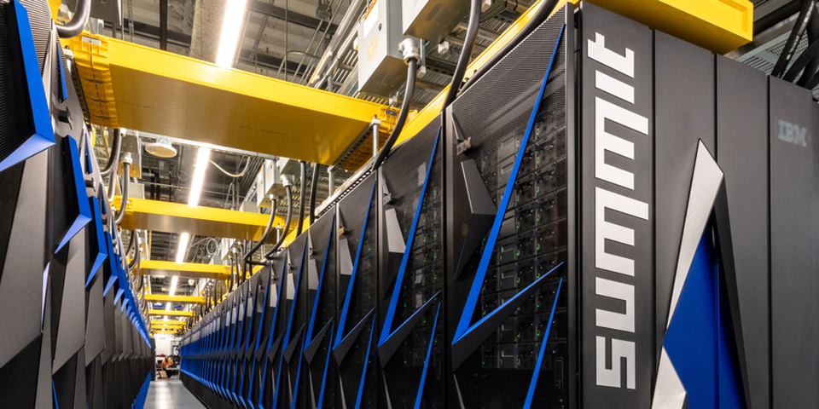
“Summit” at Oak Ridge National Labs
200 petaflops (200,000 trillion calculations/second)
27,608 NVIDIA V100 GPUs
Notes:
Allowed for training of large and expressive neural networks

Slide 23
In comparison, RL…
Requires no initial understanding of problem
Not dependent on model accuracy

Slide 24
In comparison, RL…
Requires no initial understanding of problem
Not dependent on model accuracy
Little chance for human input

Slide 25
In comparison, RL…
Requires no initial understanding of problem
Not dependent on model accuracy
Fast at deployment
Little chance for human input

Slide 26
In comparison, RL…
Requires no initial understanding of problem
Not dependent on model accuracy
Fast at deployment
Little chance for human input
Requires a large amount of training data (probably from simulator)
Requires large amount of computation at training time

Slide 27
In comparison, RL…
Requires no initial understanding of problem
Not dependent on model accuracy
Fast at deployment
Can re-train and chase moving optimum
Little chance for human input
Requires a large amount of training data (probably from simulator)
Requires large amount of computation at training time

Slide 28
Mathematically, what is RL?
What makes RL hard?
What has changed in the last few years?
Results from application to process control

Slide 29


Tom Adams,
McMaster University
Chesley Krug and Patrick Bishop,
US Naval Academy
Results from application to process control

Slide 30
Constant flow of Chemical A
Controllable concentration
of Chemical B
Injection of heat
through steam jacket
Concentration of
Chemical C
Temperature of
solution

Slide 31
Constant flow of Chemical A
Controllable concentration
of Chemical B
Injection of heat
through steam jacket
Concentration of
Chemical C
Temperature of
solution

Slide 32
Constant flow of Chemical A
Controllable concentration
of Chemical B
Injection of heat
through steam jacket
Concentration of
Chemical C
Temperature of
solution

Slide 33
Notes:
Reward is negative distance squared, so closer is higher reward

Slide 34
Dynamic Matrix Control (DMC) w/ Perfect Control Assumption
Notes:
In simulation, a very strong comparison point – model matches the problem exactly
Forced to re-solve an optimization problem every timestep

Slide 35
Neural Net Statistics
25M (s,a,r,s’) datapoints
3 hidden layers, 64 neurons per layer
Proximal Policy Optimization (PPO)*, as implemented by OpenAI
4 Nvidia P100 GPUs
4 hours
* Schulman et al., Proximal Policy Optimization Algorithms, 2017

Slide 36
Average squared, scaled distance to setpoint, first 20 timesteps

Slide 37
3 RL Runs
DMC

Slide 38
3 RL Runs
DMC

Slide 39
Can we train a model to target an arbitrary setpoint?

Slide 40



Abdulmajid Murad, Kerstin Bach, and Frank Kraemer,
NTNU
Results from application to process control
Murad, Kraemer, Bach, and Taylor.
Autonomous Management of Energy-Harvesting IoT Nodes Using Deep Reinforcement Learning. IEEE SASO, 2019.

Slide 41
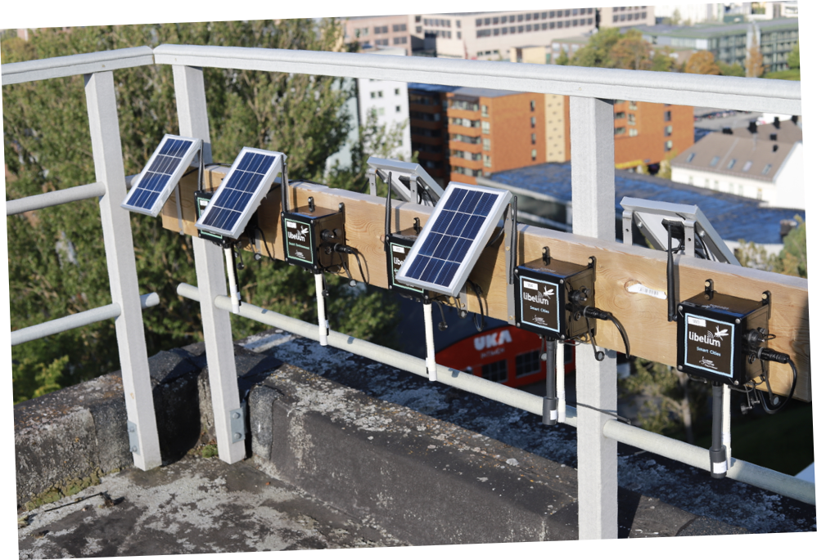

Slide 42


Slide 44
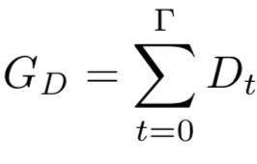
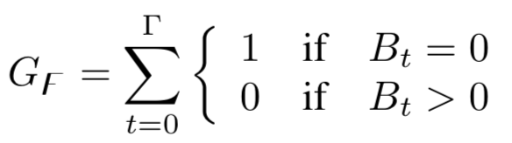
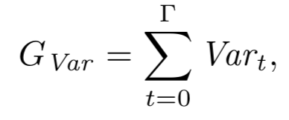
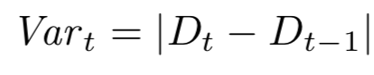
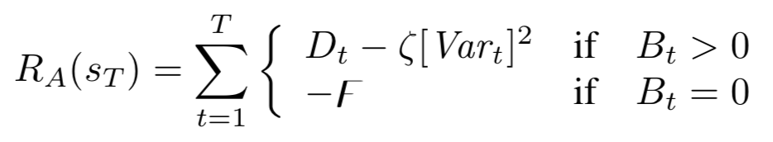
Reward Function
Objectives?
We want the agent to maximize the sum of the duty cycle over time:
We want to minimize the occurrence of failures over time:
We want to minimize the variance of the selected duty cycles
Combined conflicting objectives into one reward function:

Slide 45
Performance Results

Slide 46
Performance Results
Thank you!
Gavin Taylor, US Naval Academy
taylor@usna.edu

Slide 47
Mathematically, what is RL?
What makes RL solvable?
What makes RL hard?
What has changed in the last few years?
Preliminary results from application to process control

Slide 48
(nearly) All Machine Learning
Given:
Data
Predictive function with parameters
Error function
Minimize by tuning

Slide 49
Bellman Error
Notes:
Value function is useful for POLICY CREATION or POLICY EVALUATION

Slide 50
Bellman Error
Notes:
Value function is useful for POLICY CREATION or POLICY EVALUATION

Slide 51
Bellman Error
Notes:
Value function is useful for POLICY CREATION or POLICY EVALUATION

